Slide 1


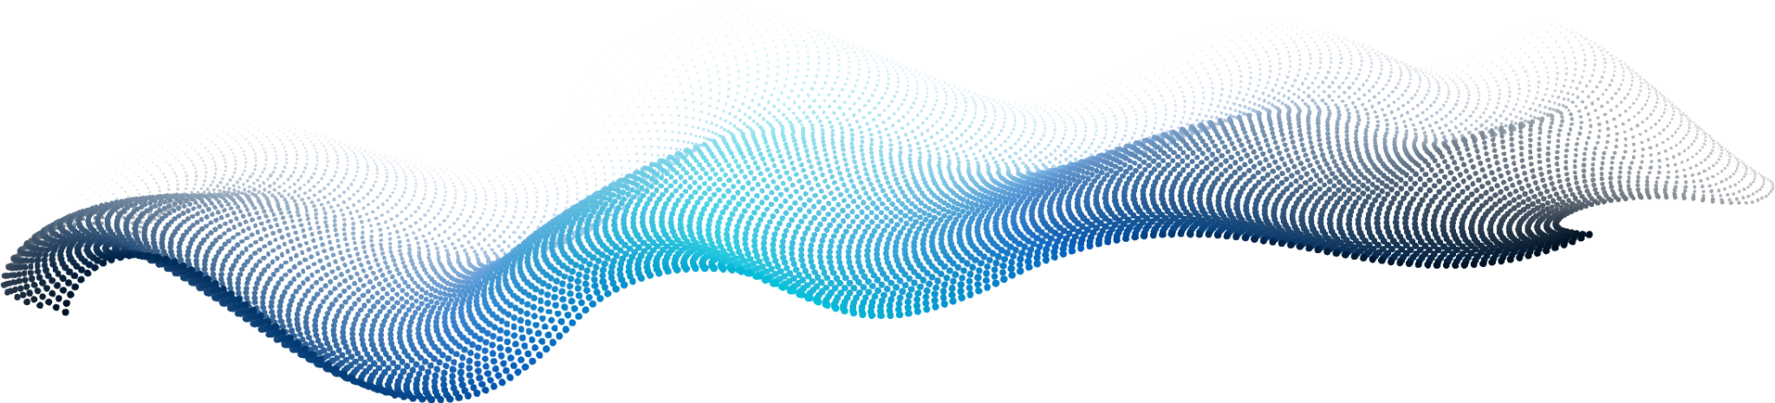
POT-SHAPED
GRAPH ANALYZER
BA MALAZA 220029283 & 220048806 RJ ZITHA

Slide 2
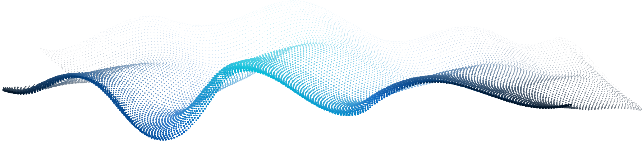
TABLE OF CONTENTS
01
02
PROBLEM STATEMENT
PROBLEM SOLUTION
Pothole graph analyzer
Using Graph ADT
03
04
ALGORITHM’S USED
DEMO
Pathfinding Dijkstra’s, and A*
Similarity Detector
How project works, Look and feel
UI design
You can describe the topic of the section here
You can describe the topic of the section here

Slide 3
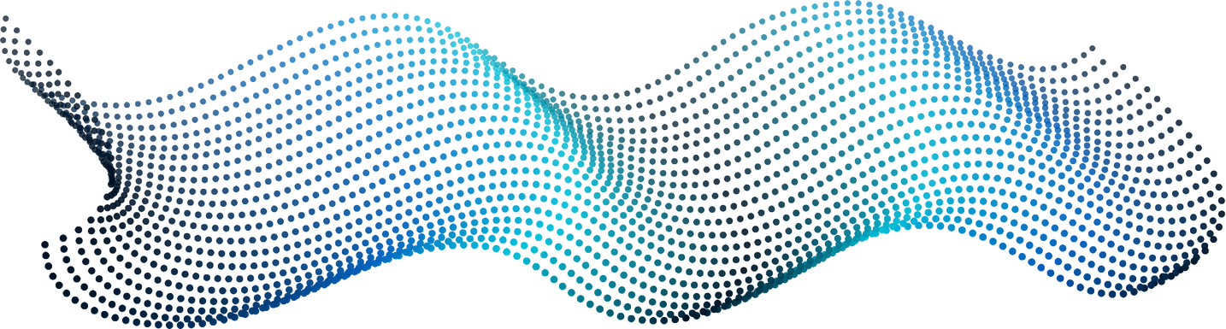
PROBLEM STATEMENT
South Africa has two common things all people can relate too first one being Loadshedding, and second being Potholes in our roads.
We know the pain of hitting a pothole when driving your car, you can even feel the pain of the driver if you’re traveling on a uber/public transport , it can damage vehicles, delay trips and cause serious accidents.
Traditional pothole detection methods manual inspections and visual surveys are slow, labour-intensive, and often ineffective, especially in rural or remote areas.
CORE PROBLEM
There are no efficiient, scalable tools to acccess road conditions in rural areas and help both drivers and authorities tackle pothole related issues.

Slide 4
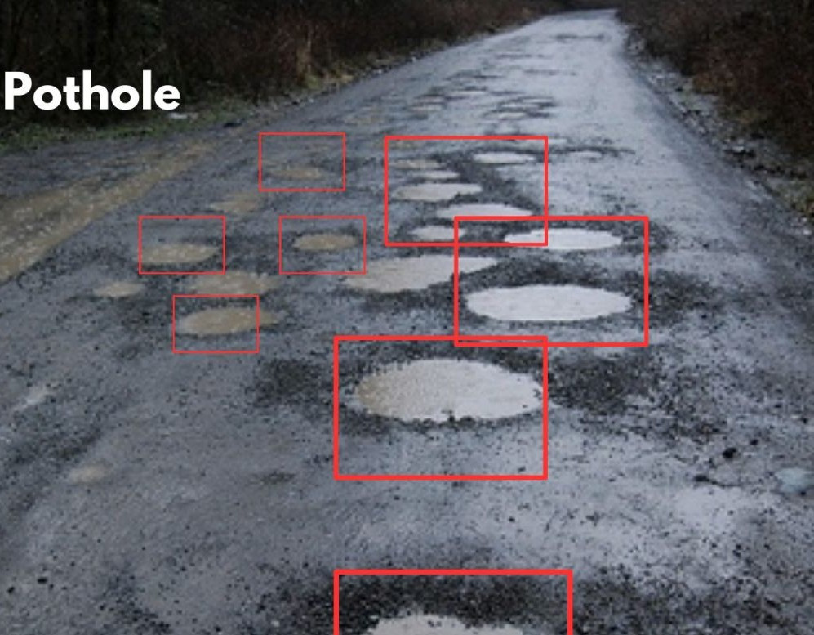
PROBLEM SOLUTION
We are developing an image analysis-based system that detects and evaluates potholes by analysing road surface images using two key techniques:
Graph-Based Pathfinding: Road images are converted into graph representations, allowing the system to trace paths and identify disruptions indicative of cracks or potholes.
Image Similarity Detection: The system compares new road images with known samples of damaged surfaces to detect and flag similarities consistent with potholes.

Slide 5
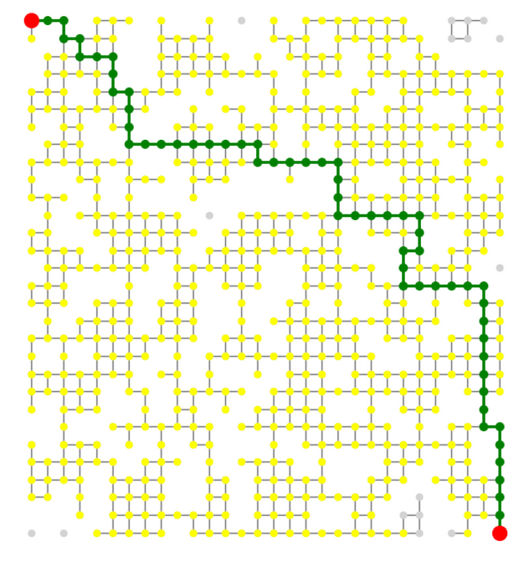
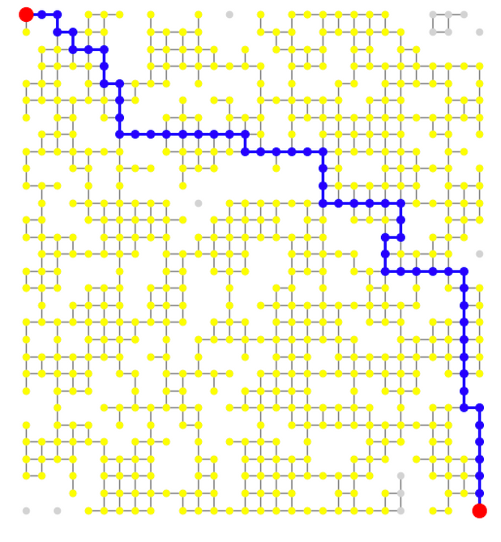
PATHFINDING ALGORITHM’S
Address the problem finding a good path, from starting point to a goal avoiding obstacles.
Dijkstra’s algorithm finds the shortest path between two points based purely on edge weights.
DIJSTRA’S ALGORITHM’S
A* improves this by adding a heuristic the estimated distance to the goal making it faster for large graphs.
A* ALGORITHM

Slide 6
SIMILARITY DETECTION
Finds most similar regions between Images using K-Nearest Neighbor Modeling
We use a k-Nearest Neighbor (k-NN) method where we compare the feature vectors of regions from two images and calculate an average distance, lower distances mean the images are more similar.
How we calculate is 40% features, 30% Structure , and 30% K-NN

Slide 7
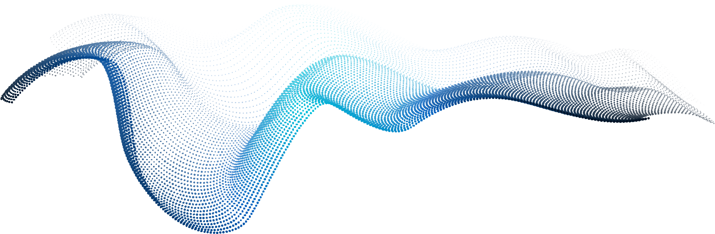

STEP 1: USER INTERFACE

Slide 8
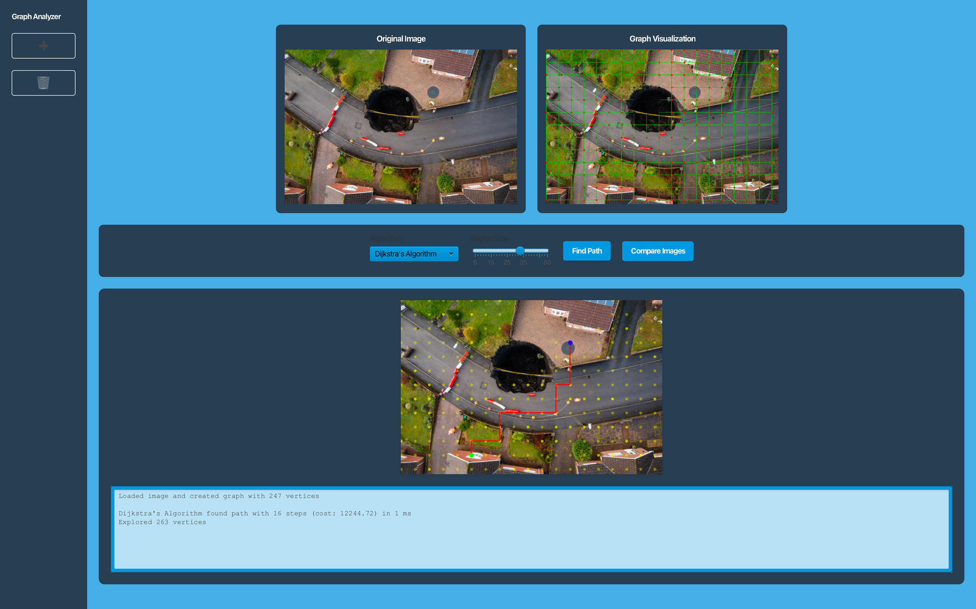
STEP 2: PATHFINDING ALGORITHM VISUALIZATION

Slide 9
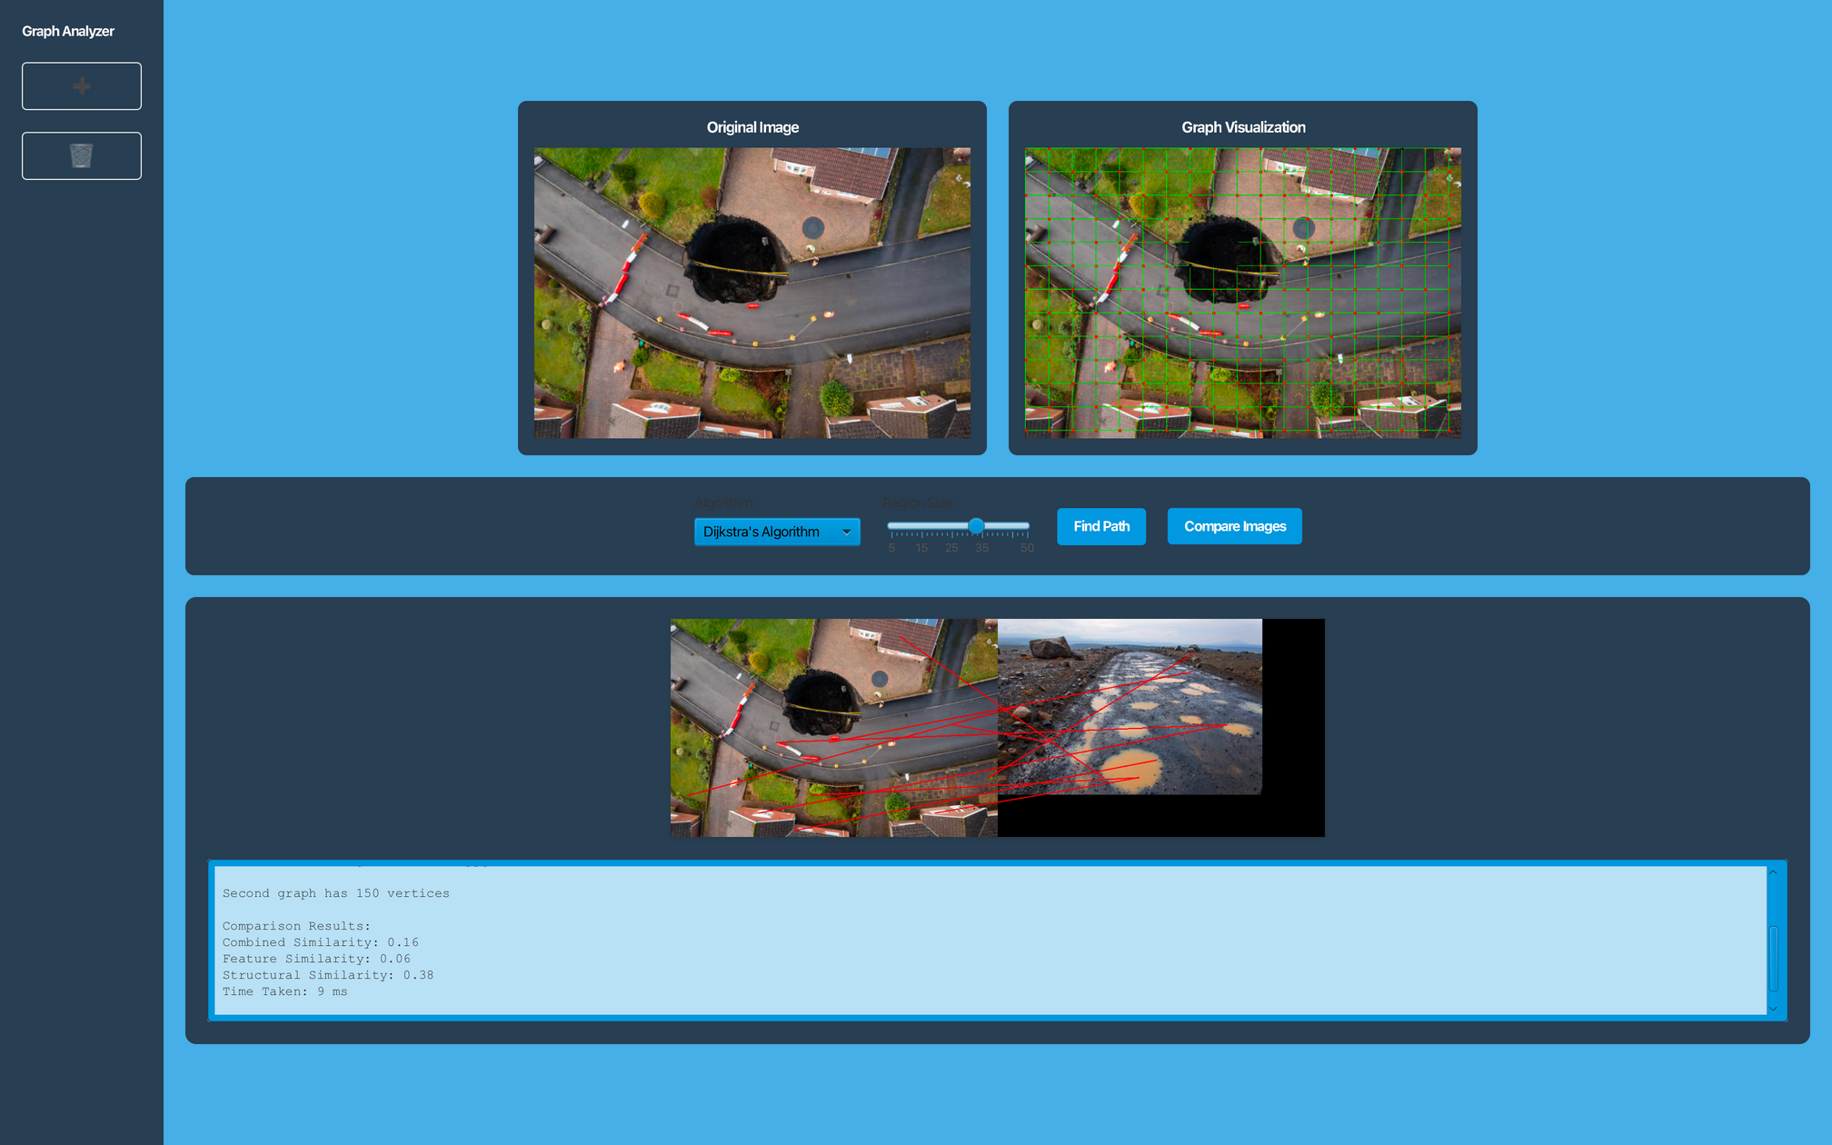
STEP 3: SIMILARITY DETECTION VISUALIZATION

Slide 10
DEMO

Slide 11
THANK YOU

